Slide 1
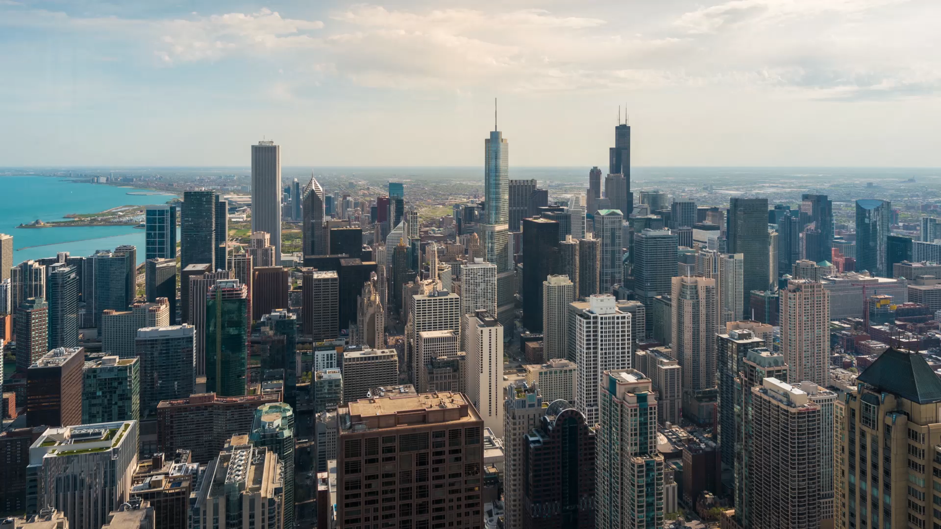
Covid 19 and Social Distancing
With Covid Policy and Natural distancing effect

Slide 2

Social Distancing
Isolation
1.5m/ 6ft protocol
Masking
Lockdown
Qian, M., & Jiang, J. (2020). COVID-19 and social distancing. Journal of Public Health, 1-3.

Slide 3
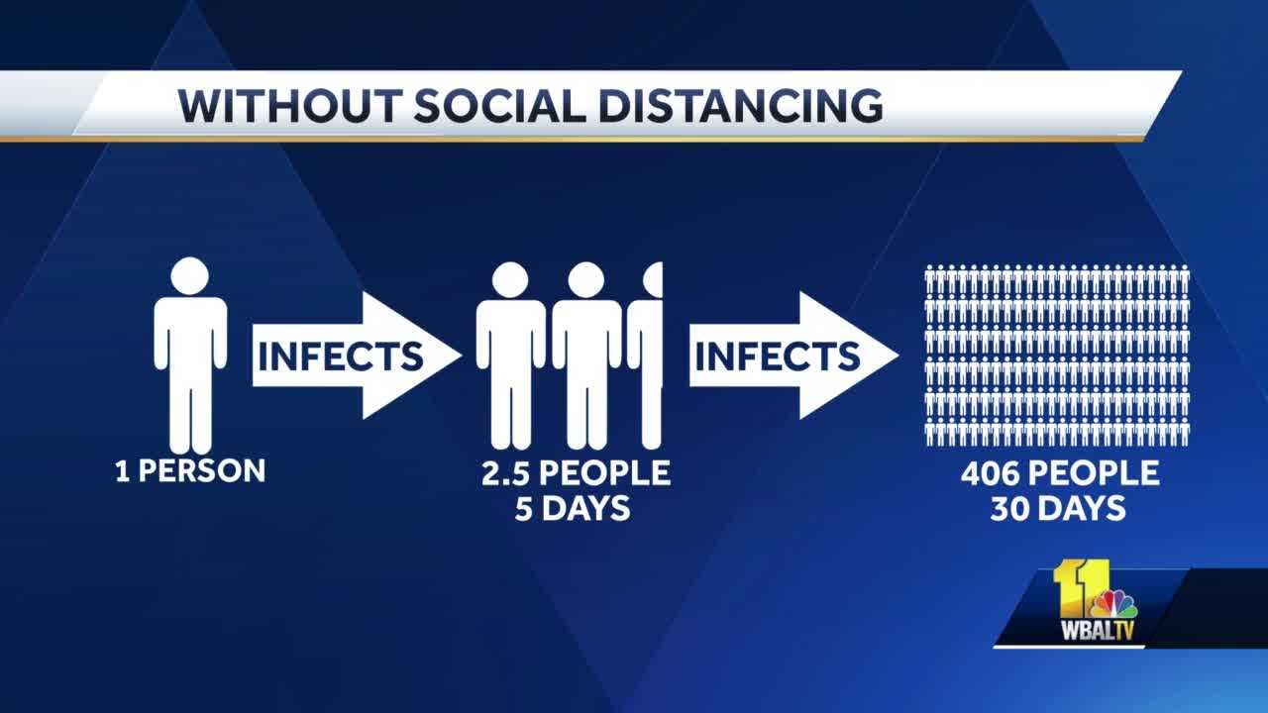

Slide 4
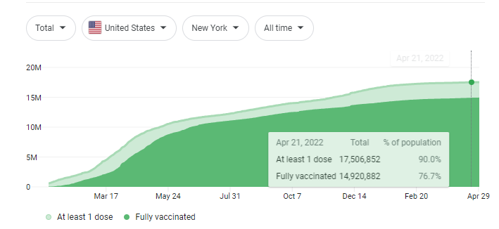
Vaccination

Slide 5
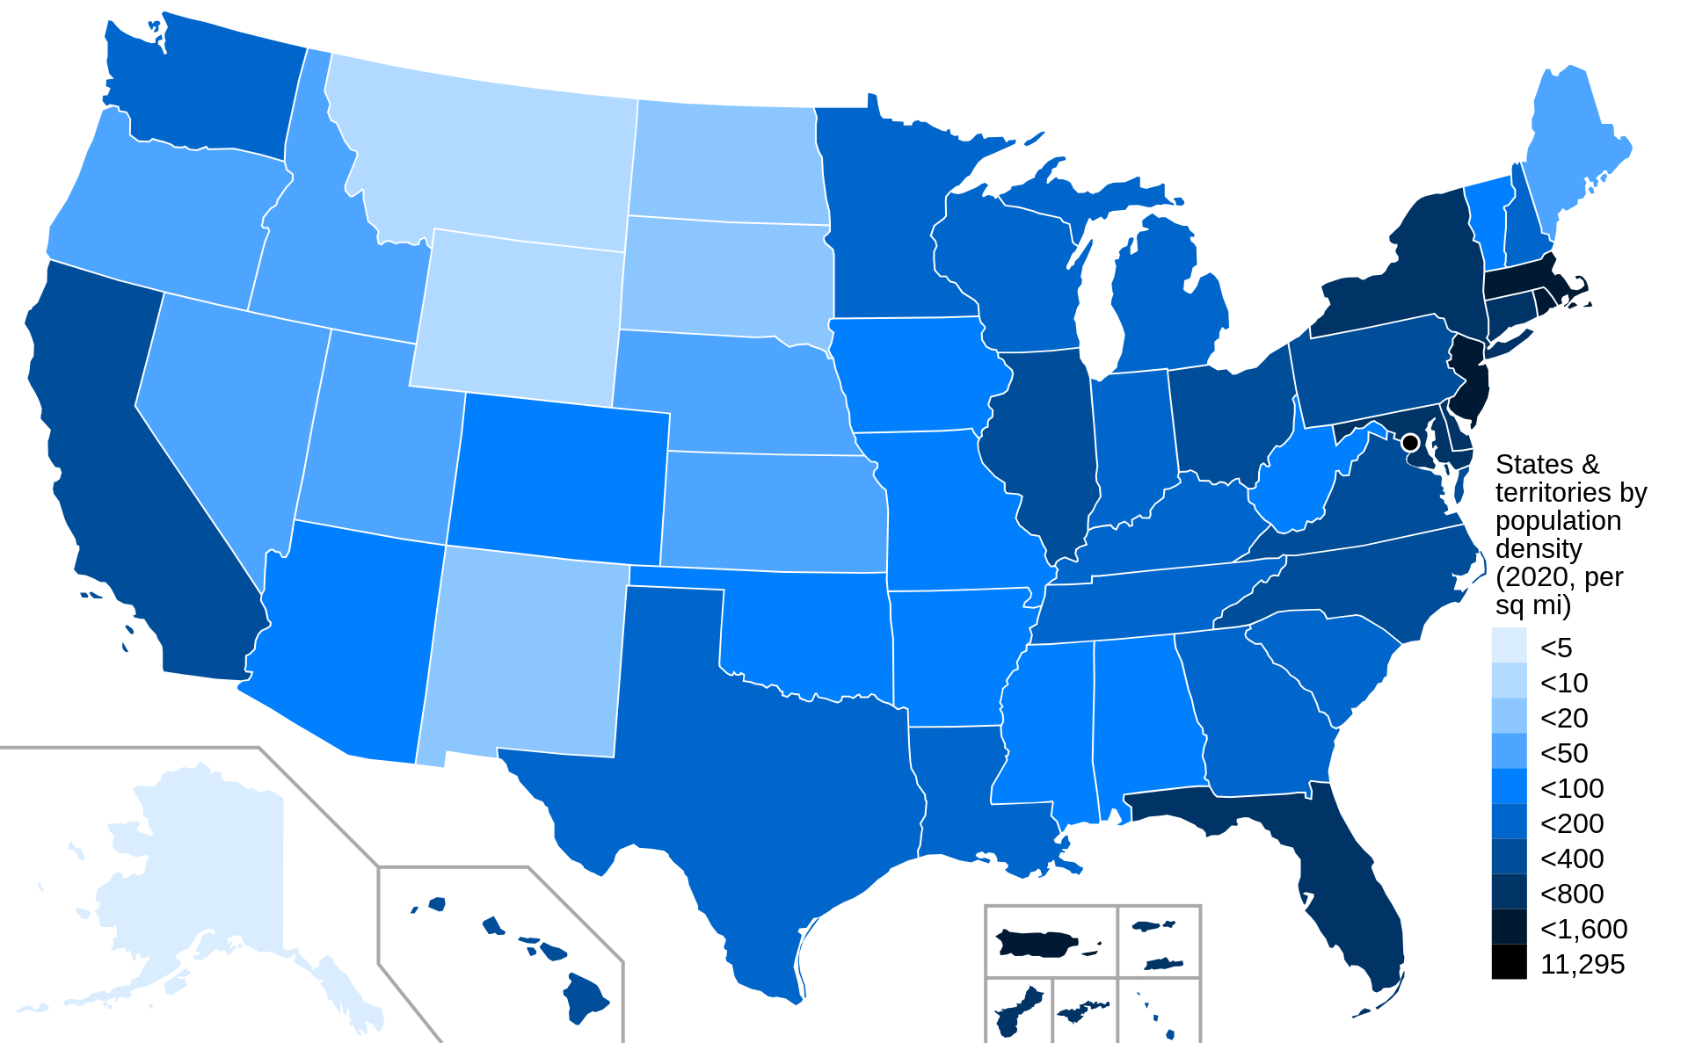
Natural Distancing
Jawad, A. J. (2020). Effectiveness of population density as natural social distancing in COVID19 spreading. Ethics, Medicine and Public Health, 15, 100556.

Slide 6
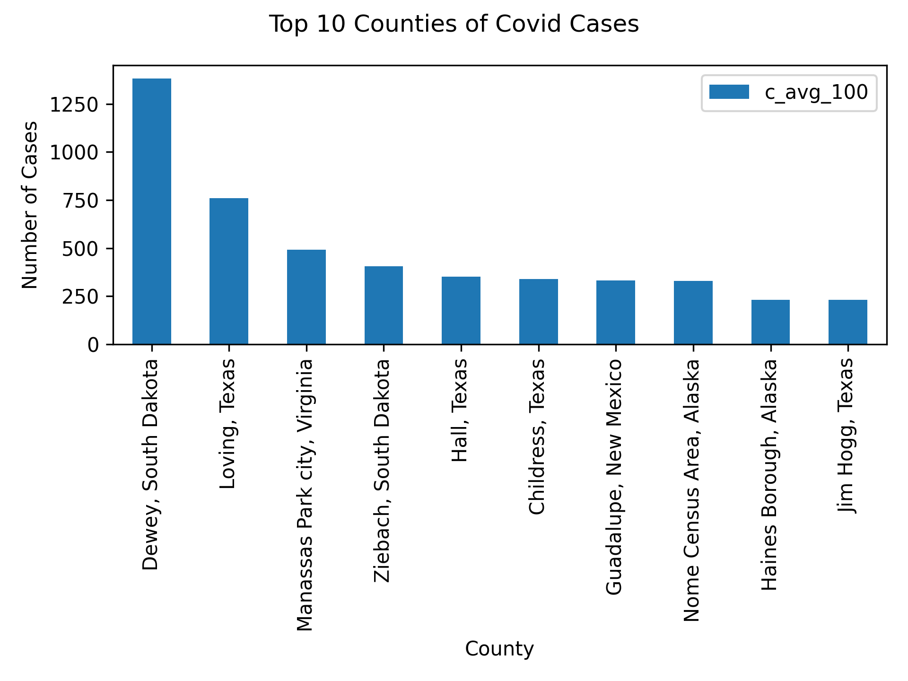
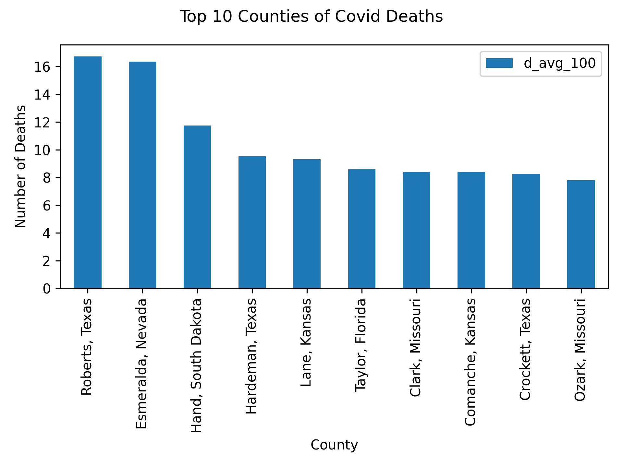

Slide 7
Continuing work
Population density per county
Identify correlation between density and covid cases
Geocode the data and show visualization through map (TBD)

